Slide 1
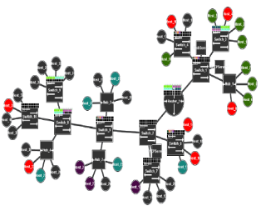
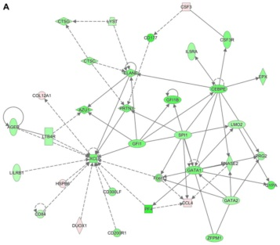
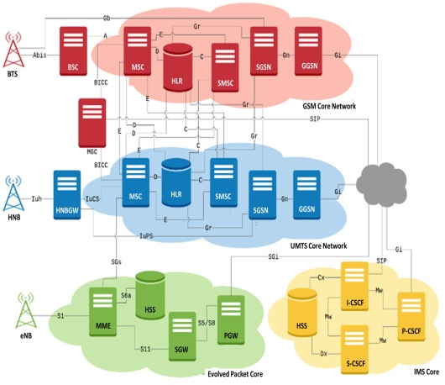


“Tools For Network Simulation”
PRESENTATION TITLE:

Slide 2


TEAM MEMBERS ARE:
AREEBA ZAFAR
ABDUL AHAD

Slide 3
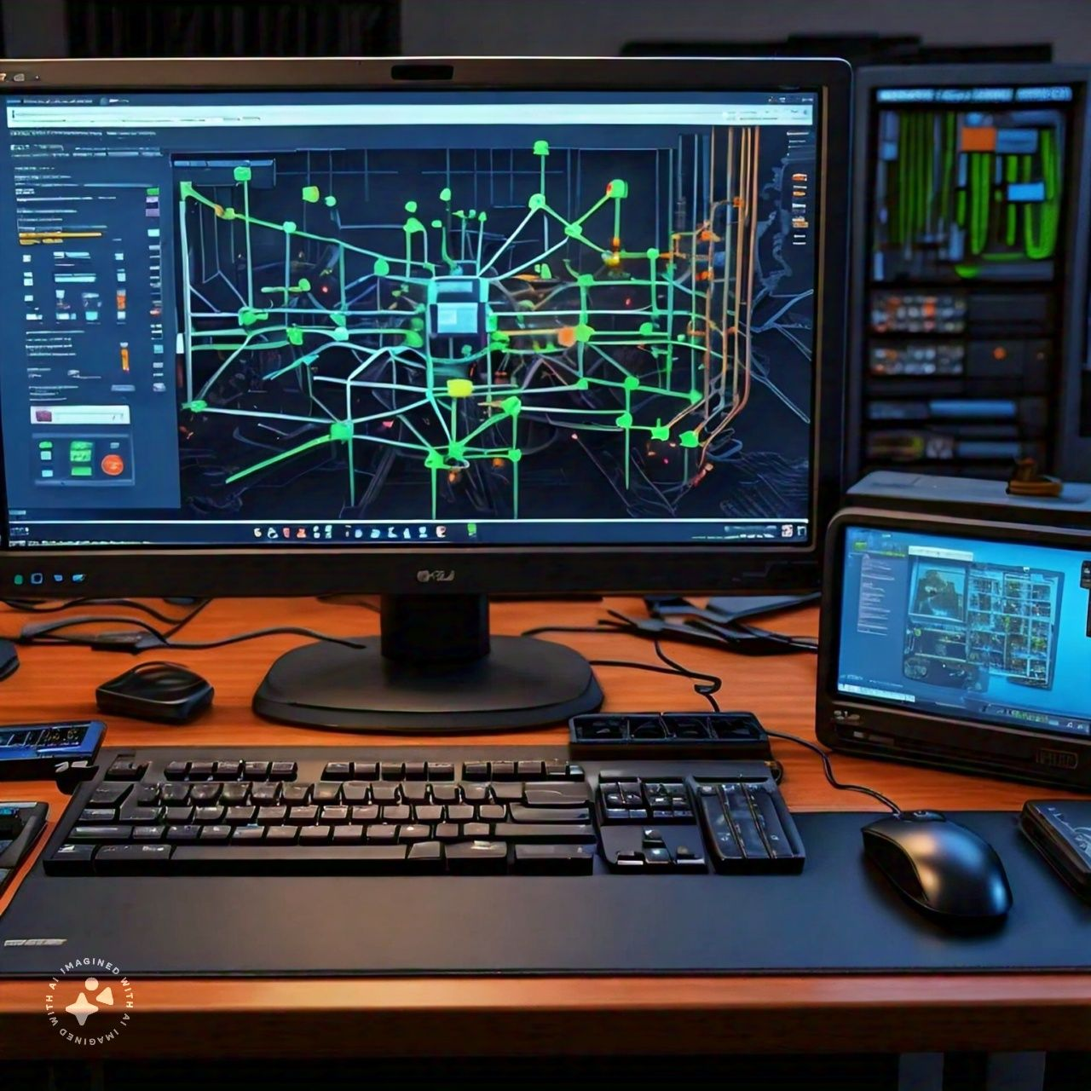
WHAT IS NETWORK SIMULATION ?
Network simulation is a method of creating a virtual environment to mimic real-world networks, allowing for testing, analysis, and optimization of network configurations and behaviors without physical implementation. It helps in understanding network performance, behavior, and interactions in a controlled and repeatable manner.

Slide 4


WE USE NETWORK SIMULATION ?
We use network simulation to test and predict how computer networks will perform in different scenarios without the need for physical implementation. It helps us evaluate network designs, protocols, and configurations efficiently.

Slide 5
LIST OF SIMULATION PLATFORMS:
GNS3 (Graphical Network Simulator-3)
EVE-NG (Emulated Virtual Environment Next-Generation)
NS-3 (Network Simulator-3)
OMNeT++ (Objective Modular Network Testbed in C++)
NetSim (Network Simulator)
WireShark
Opnet (now Riverbed Modeler)
Simulink
QualNet
NetSimulator

Slide 6
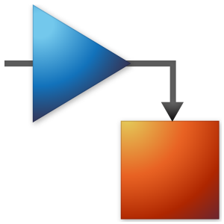
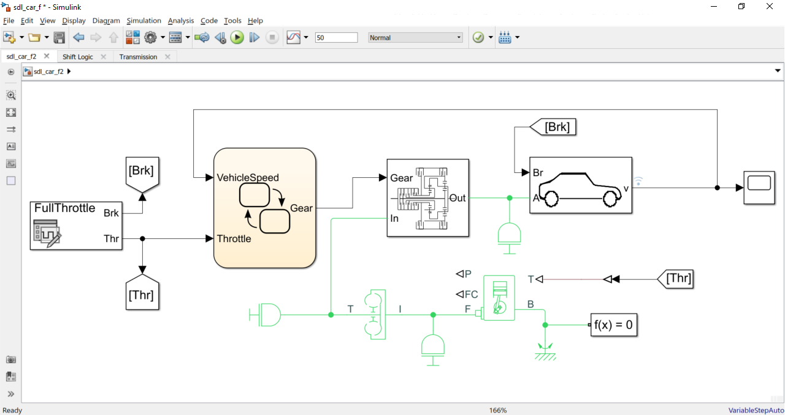
Simulink

Slide 7
OVERVIEW:
YEAR
1984
USER RATIO
HIGH
MARKETING RATIO
HIGH
EASE OF USE
MODERATE TO EASY (VISUAL MODELING)
COST
PAID (COMMERCIAL SOFTWARE)
TIME CONSUMPTION
LOW TO MODERATE
PROFESSIONAL USE
WIDELY USED IN ENGINEERING & RESEARCH

Slide 8

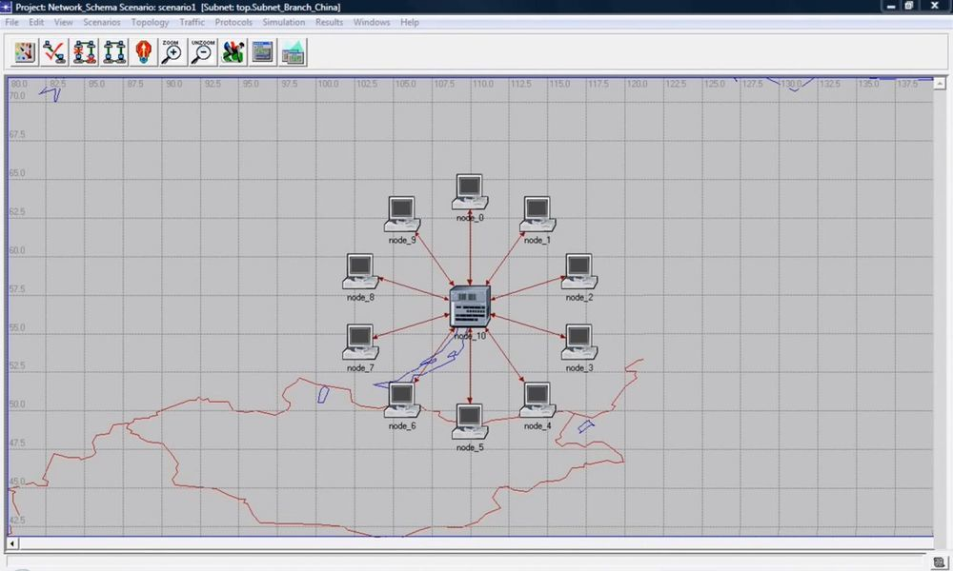
RIVERBED MODELER

Slide 9
OVERVIEW:
YEAR
1986
USER RATIO
LOW
MARKETING RATIO
MODERATE
EASE OF USE
MODERATE TO DIFFICULT (LEARNING CURVE FOR BEHINNERS)
COST
PAID (COMMERCIAL SOFTWARE)
TIME CONSUMPTION
HIGH (DUE TO LEARNING CURVE)
PROFESSIONAL USE
MAINLY FOR NETWORK PROFESSIONALS & RESEARCHERS

Slide 10

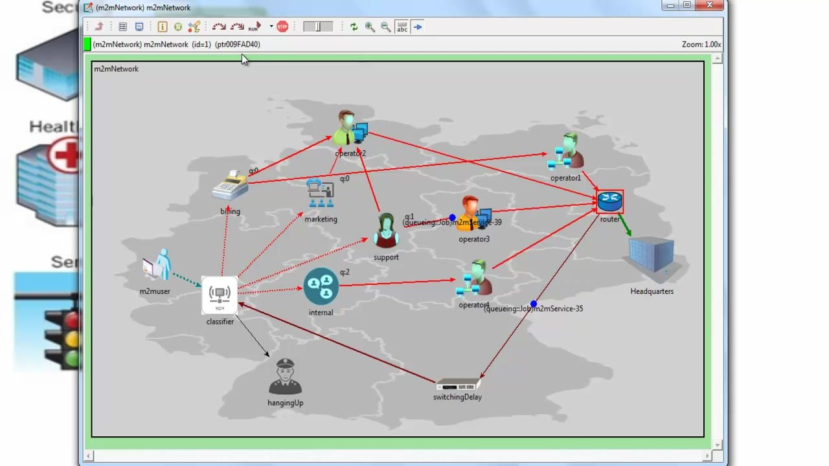
OMNeT ++

Slide 11
OVERVIEW:
YEAR
1992
USER RATIO
LOW
MARKETING RATIO
LOW
EASE OF USE
DIFFICULT ( REQUIRES PROGRAMMING SKILLS)
COST
FREE
TIME CONSUMPTION
HIGH (DUE TO PROGRAMMING REQUIREMENTS)
PROFESSIONAL USE
MAINLY FOR RESEARCHS & ACADEMICS

Slide 12

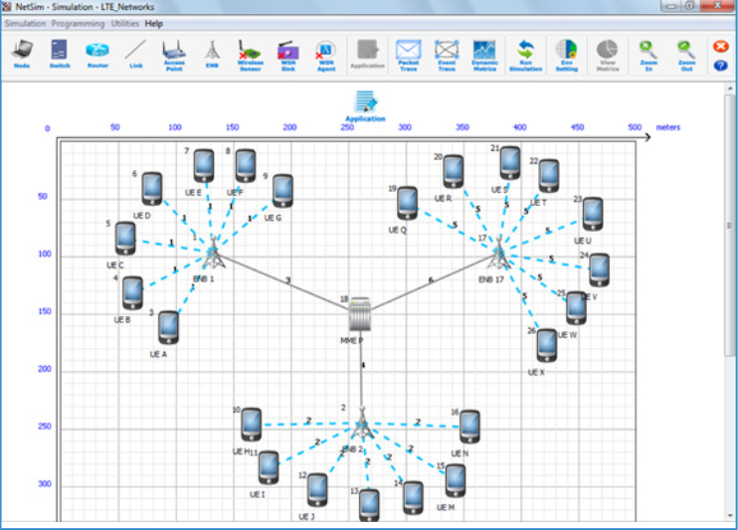

Slide 13
OVERVIEW:
YEAR
1993
USER RATIO
MODERATE
MARKETING RATIO
HIGH
EASE OF USE
EASY (USER-FRIENDLY INTERFACE)
COST
PAID (COMMERCIAL SOFTWARE)
TIME CONSUMPTION
LOW TO MODERATE
PROFESSIONAL USE
SUITABLE FOR BOTH STUDENTS & PROFESSIONALS

Slide 14

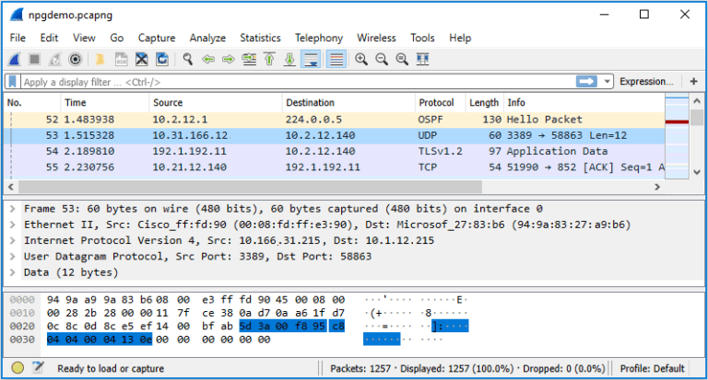
WIRESHARK

Slide 15
OVERVIEW:
YEAR
1998
USER RATIO
HIGH
MARKETING RATIO
HIGH
EASE OF USE
EASY (USER-FRIENDLY PACKET ANALYSIS)
COST
FREE
TIME CONSUMPTION
LOW TO MODERATE
PROFESSIONAL USE
WIDELY USED IN NETWORKING PROFESSIONALS & SECURITY ANALYSIS

Slide 16

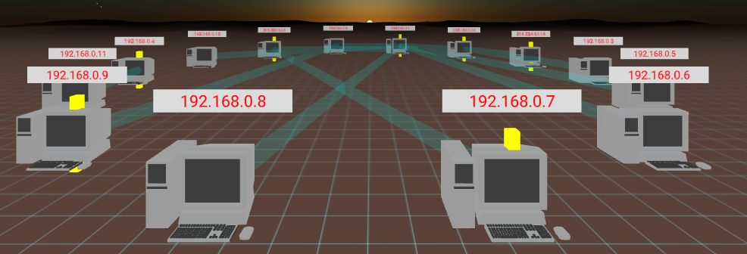
Net Simulator

Slide 17
OVERVIEW:
YEAR
1999
USER RATIO
MODERATE
MARKETING RATIO
LOW
EASE OF USE
EASY TO MODERATE (INTUITIVER INTERFACE, SUITABLE FOR BEGINNERS)
COST
PAID (COMMERCIAL SOFTWARE)
TIME CONSUMPTION
LOW TO MODERATE
PROFESSIONAL USE
SUITABLE FOR BOTH STUDENTS & PROFESSIONALS

Slide 18

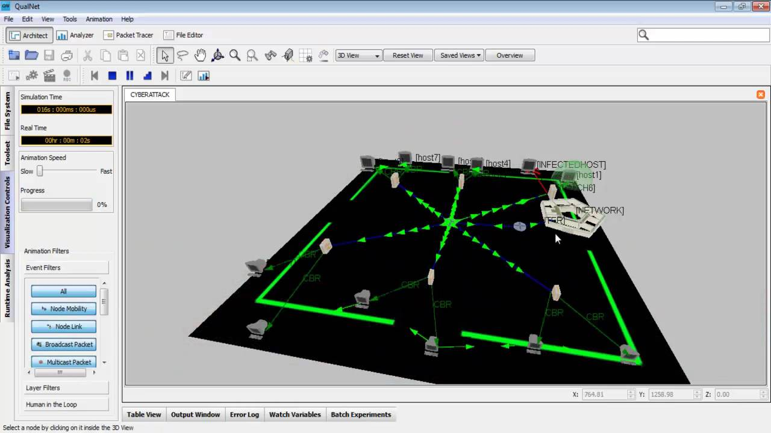

Slide 19
OVERVIEW:
YEAR
2001
USER RATIO
MODERATE
MARKETING RATIO
MODERATE
EASE OF USE
MODERATE TO DIFFICULT(ADVANCED FEATURE)
COST
PAID (COMMERCIAL SOFTWARE)
TIME CONSUMPTION
MODERATE TO HIGH
PROFESSIONAL USE
MAINLY FOR RESEARCHERS & PROFESSIOANLS IN NETWORK SIMULATION

Slide 20

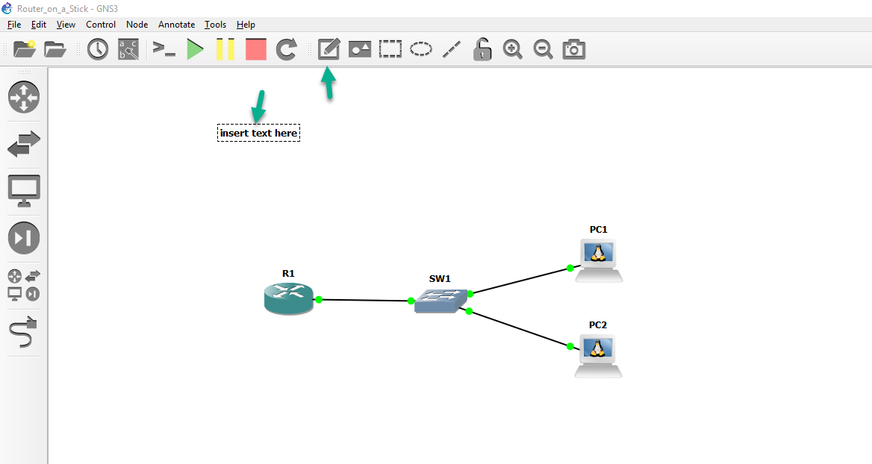
GNS3

Slide 21
OVERVIEW:
YEAR
2007
USER RATIO
HIGH
MARKETING RATIO
MODERATE
EASE OF USE
MODERATE(REQUIRES SOME TECHNICAL KNOWLEDGE)
COST
FREE
TIME CONSUMPTION
MODERATE TO HIGH ( DEPENDING ON SETUP COMPLEXITY)
PROFESSIONAL USE
SUITABLE FOR BOTH STUDENTS & PROFESSIONALS

Slide 22
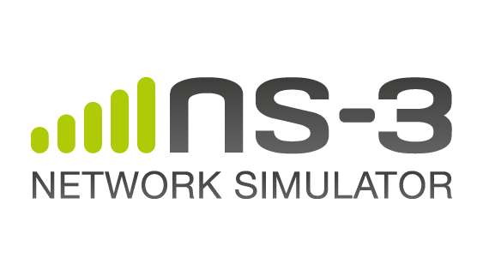
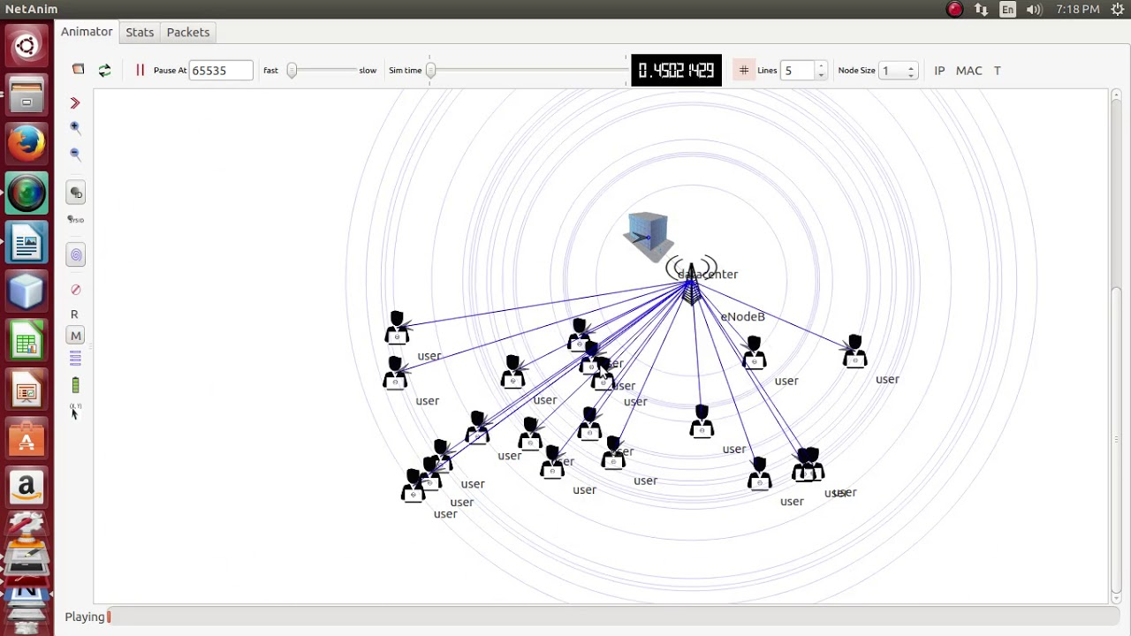

Slide 23
OVERVIEW:
YEAR
2008
USER RATIO
LOW
MARKETING RATIO
LOW TO MODERATE
EASE OF USE
DIFFICULT (REQUIRES PROGRAMMING SKILLS)
COST
FREE
TIME CONSUMPTION
HIGH (DUE TO PROGRAMMING REQUIREMENTS)
PROFESSIONAL USE
MORE SUITABLE FOR RESEARCHERS & ACADEMICS

Slide 24

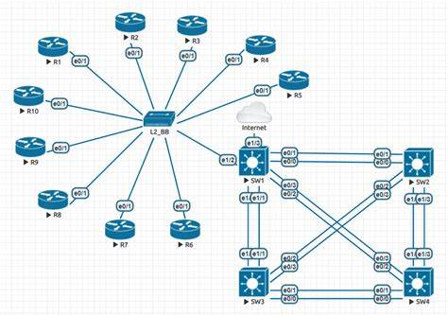

Slide 25
OVERVIEW:
YEAR
2014
USER RATIO
MODERATE
MARKETING RATIO
LOW
EASE OF USE
MODERATE TO DIFFICULT(REQUIRES MANUAL SETUP & CONFIGURATION)
COST
FREE(WITH LIMITATION),PAID VERSION AVAILABLE
TIME CONSUMPTION
HIGH ( DUA TO MANUAL SETUP)
PROFESSIONAL USE
MORE SUITABLE FOR PROFESSIONALS & ADVANCED USERS

Slide 26

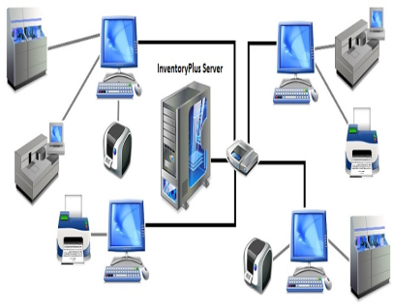
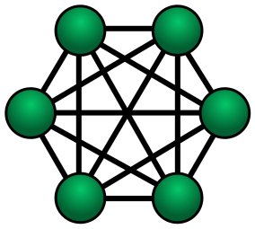






WHICH TOOL IS BEST FOR STUDENTS?
For students, “GNS3” (Graphical Network Simulator-3) is considered the best choice. It offers a user-friendly interface and supports a wide range of devices, making it suitable for learning networking concepts. GNS3 allows students to design, configure, and test network topologies using both real and virtual devices. Additionally, GNS3 has a large community and extensive documentation, providing ample resources for students to explore and learn network simulation effectively.
Product pitch
TOPOLOGIES
CONFIGURATION
TEST NETWORK
DESIGN

Slide 27

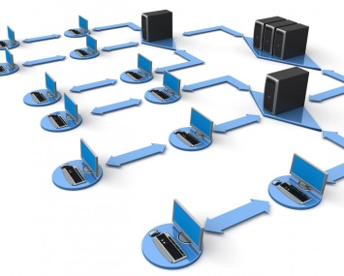
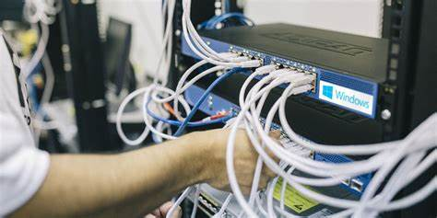
WHICH TOOL IS BEST FOR PROFESSIONALS?
For professionals, the tool best suited would be “Wireshark”. It offers comprehensive packet analysis capabilities, making it indispensable for network professionals and security analysts. Its user-friendly interface, extensive protocol support, and real-time packet inspection features make it an essential tool for diagnosing network issues, troubleshooting, and ensuring network security. Additionally, Wireshark's widespread adoption in the industry and active community support contribute to its suitability for professionals.
Product pitch
CONFIGURATION
SECURITY ANALYSIS
REAL-TIME PACKET
TROUBLESHOOTING

Slide 28
Websites for Network Simulation Tools and Resources
1. GNS3: Official Website: https://www.gns3.com/ , Documentation and Tutorials: https://docs.gns3.com/
2. EVE-NG:Official Website: https://www.eve-ng.net/ , Community Forums: https://www.eve-ng.net/forum/
3. NS-3: Official Website: https://www.nsnam.org/ , Documentation: https://www.nsnam.org/docs/
4. OMNeT++: Official Website: https://omnetpp.org/ , Documentation and Tutorials: https://omnetpp.org/documentation/
5. NetSim: Official Website: https://www.tetcos.com/netsim.html
6. Wireshark: Official Website: https://www.wireshark.org/ ,User Guide: https://www.wireshark.org/docs/wsug_html_chunked/
7. Opnet (now Riverbed Modeler): Official Website: https://www.riverbed.com/gb/products/steelcentral/opnet.html
8. Simulink: Official Website: https://www.mathworks.com/products/simulink.html , Documentation and Tutorials: https://www.mathworks.com/help/simulink/
9. QualNet: Official Website: https://www.scalable-networks.com/ , Product Overview: https://www.scalable-networks.com/products/qualnet
10. NetSimulator: Official Website: Varies based on the specific tool.

Slide 29


